Slide 1
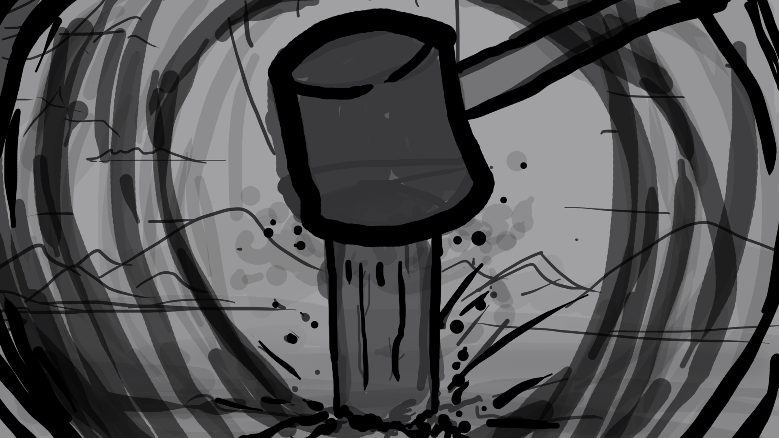
Will you be the one to hammer the first stake into the ground?

Slide 2
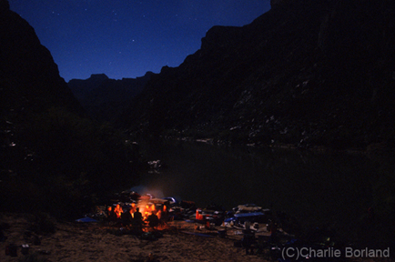
Will you be the one to light the first fire in the dark?

Slide 3
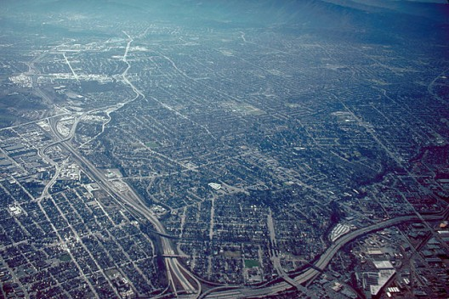
Will you be the one to govern a city that stretches beyond the Horizon?

Slide 4
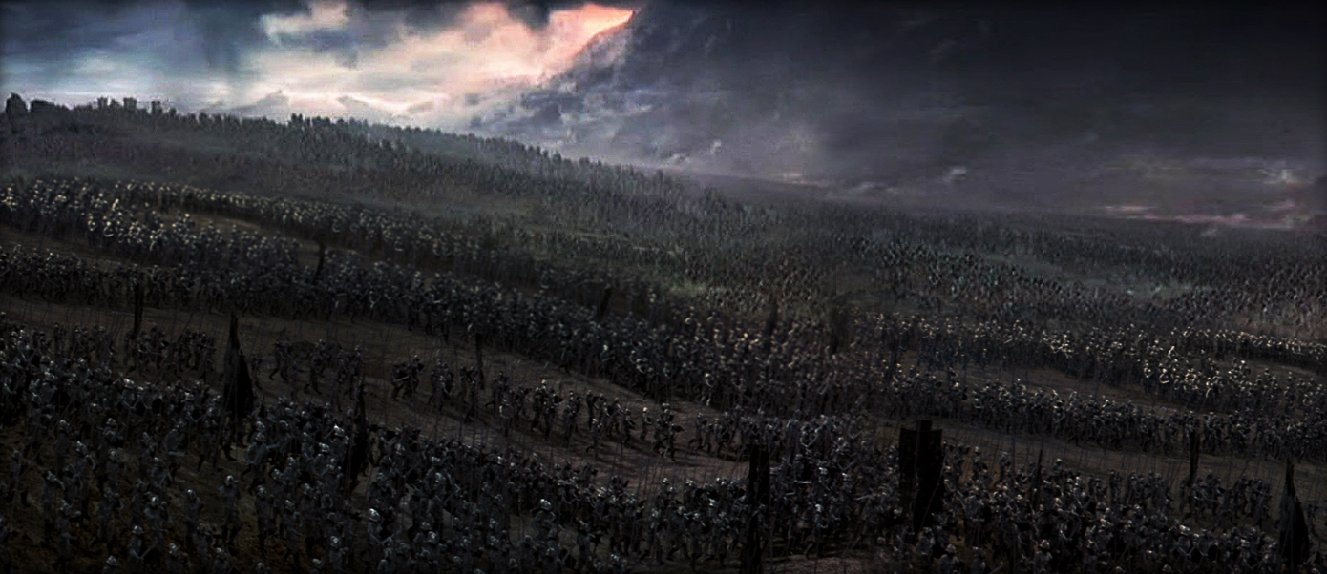
Will you be the one to lead an army that will crush all that stands in their way?

Slide 5

SURVIVAL IS JUST THE BEGINNING...

